Slide 1
IP Addressing

Slide 2
Addressing Modes
IPv4 supports three different types of addressing modes.
  Unicast Addressing Mode
  Broadcast Addressing Mode
  Multicast Addressing Mode
Every network has one IP address reserved for the Network Number which represents the network and one IP address reserved for the Broadcast Address, which represents all the hosts in that network.

Slide 3
Unicast Addressing Mode
In this mode, data is sent only to one destined host.
The Destination Address field contains 32- bit IP address of the destination host.
Here the client sends data to the targeted server

Slide 4
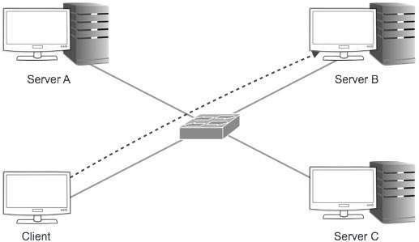
Unicast Addressing Mode

Slide 5
Broadcast Addressing Mode
In this mode, the packet is addressed to all the hosts in a network segment.
The Destination Address field contains a special broadcast address, i.e. 255.255.255.255.
When a host sees this packet on the network, it is bound to process it.
Here the client sends a packet, which is entertained by all the Servers

Slide 6
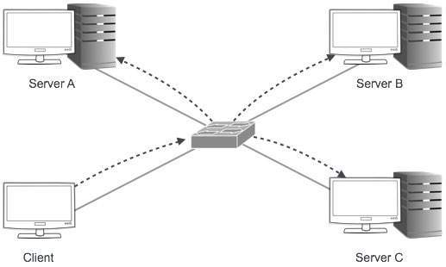
Broadcast Addressing Mode

Slide 7
Multicast Addressing Mode
This mode is a mix of the previous two modes, i.e. the packet sent is neither destined to a single host nor all the hosts on the segment.
In this packet, the Destination Address contains a special address which starts with 224.x.x.x and can be entertained by more than one host.
Here a server sends packets which are entertained by more than one servers.

Slide 8
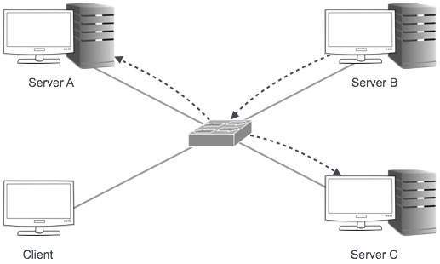
Multicast Addressing Mode

Slide 9
Anycasting
Sometimes, the same IP services are provided by different hosts. For example, a user wants to download a file using FTP and the file is available on multiple FTP servers.
Hosts that implement the same service provide an anycast address to other hosts that require the service.
Connections are made to the first host in the anycast address group to respond.
This process is used to guarantee the service is provided by the host with the best connection to the receiver.

Slide 10
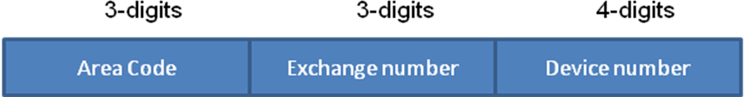
Internet Addressing
Telephone Number
Internet Protocol Address
24 bits
8 bits
IP Network
Device

Slide 11
Internet Addressing
Consider this 32 bit IP Address
  (10000000 00111101 00010111 11011000)₂
Convert each 8-bit octet into a decimal number and separate each with a decimal
  128.61.23.216
In this address the first 24 bits are network while the last 8 are the device
  128.61.23.216/24 (classless address)

Slide 12

Hierarchical Addressing Scheme
IPv4 uses hierarchical addressing scheme. An IP address, which is 32-bits in length, is divided into two or three parts as depicted −
A single IP address can contain information about the network and its sub-network and ultimately the host.
This scheme enables the IP Address to be hierarchical where a network can have many sub-networks which in turn can have many hosts.

Slide 13
Classful Addressing
In classful addressing, the address space is divided into five classes:
A, B, C, D, and E.

Slide 14
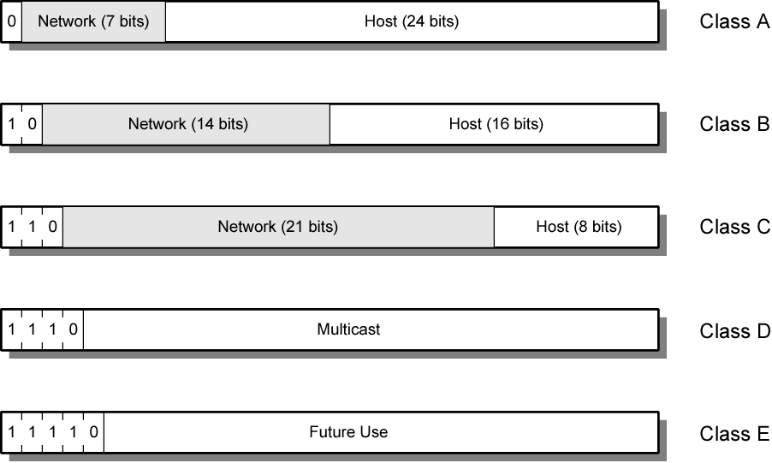
IPv4 Address Formats

Slide 15

Class A Address
32 bit global internet address
Network part (8)and host part (24)
The first bit of the first octet is always set to 0 (zero).
Range 0.0.0.0-to-127.255.255.255 ; All 0 reserved
Class A addresses only include IP starting from 1.x.x.x to 126.x.x.x only.
The IP range 127.x.x.x is reserved for loopback IP addresses.
The default subnet mask for Class A IP address is 255.0.0.0 which implies that Class A addressing can have 126 networks (2⁷-2) and 16777214 hosts (2²⁴-2).
Class A IP address format is thus: 0NNNNNNN.HHHHHHHH.HHHHHHHH.HHHHHHHH
All allocated

Slide 16

Class B Address
An IP address which belongs to class B has the first two bits in the first octet set to 10
Network part (16)and host part (16)
Range 128.x.x.x to 191.x.x.x
Second Octet also included in network address
2¹⁴ = 16,384 class B addresses
Class B IP Addresses range from 128.0.x.x to 191.255.x.x. The default subnet mask for Class B is 255.255.x.x.
Class B has 16384 (2¹⁴) Network addresses and 65534 (2¹⁶-2) Host addresses.
Class B IP address format is: 10NNNNNN.NNNNNNNN.HHHHHHHH.HHHHHHHH
All allocated

Slide 17

Class C Address
The first octet of Class C IP address has its first 3 bits set to 110,
Network part (24)and host part (8)
Range 192.x.x.x to 223.x.x.x
Second and third octet also part of network address
2²¹ = 2,097,152 addresses
Nearly all allocated
Class C IP addresses range from 192.0.0.x to 223.255.255.x. The default subnet mask for Class C is 255.255.255.x.
Class C gives 2097152 (2²¹) Network addresses and 254 (2⁸-2) Host addresses.
Class C IP address format is: 110NNNNN.NNNNNNNN.NNNNNNNN.HHHHHHHH

Slide 18

Class D Address
Very first four bits of the first octet in Class D IP addresses are set to 1110, giving a range of −
Class D has IP address range from 224.0.0.0 to 239.255.255.255.
Class D is reserved for Multicasting. In multicasting data is not destined for a particular host, that is why there is no need to extract host address from the IP address, and Class D does not have any subnet mask.

Slide 19
Class E Address
This IP Class is reserved for experimental purposes only for R&D or Study. IP addresses in this class ranges from 240.0.0.0 to 255.255.255.254. Like Class D, this class too is not equipped with any subnet mask.
Each IP class is equipped with its own default subnet mask which bounds that IP class to have prefixed number of Networks and prefixed number of Hosts per network.
Classful IP addressing does not provide any flexibility of having less number of Hosts per Network or more Networks per IP Class.

Slide 20
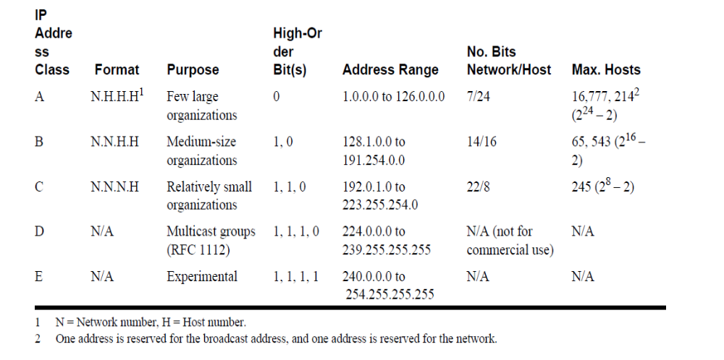

Slide 21
Some Special IP address forms
Prefix (network) | Suffix (host) | Type & Meaning
all zeros | all zeros | this computer (used during bootstrap)
network address | all zeros | identifies network
network address | all ones | broadcast on the specified network
all ones | all ones | broadcast on local network
127 | any | loopback (for testing purposes)

Slide 22
Classes and Blocks
One problem with classful addressing is that each class is divided into a fixed number of blocks with each block having a fixed size

Slide 23
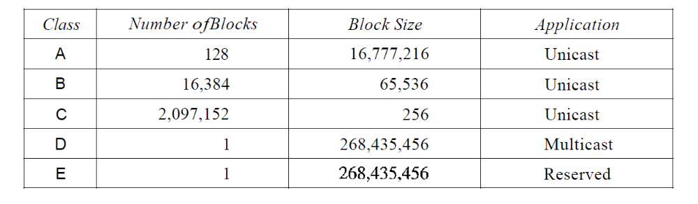
Number of blocks and block size in Classful IPv4 addressing

Slide 24
Netid and Hostid
In classful addressing, an IP address in class A, B, or C is divided into netid and hostid. These parts are of varying lengths, depending on the class of the address.
  In class A, one byte defines the netid and three bytes define the hostid.
  In class B, two bytes define the netid and two bytes define the hostid.
  In class C, three bytes define the netid and one byte defines the hostid.
This concept does not apply to classes D and E.

Slide 25
Mask
Although the length of the netid and hostid (in bits) is predetermined in classful addressing, we can also use a mask (also called the default mask), a 32-bit number made of contiguous 1s followed by contiguous 0s.
The mask can help us to find the netid and the hostid.
For example, the mask for a class A address has eight 1s, which means the first 8 bits of any address in class A define the netid; the next 24 bits define the hostid.

Slide 26
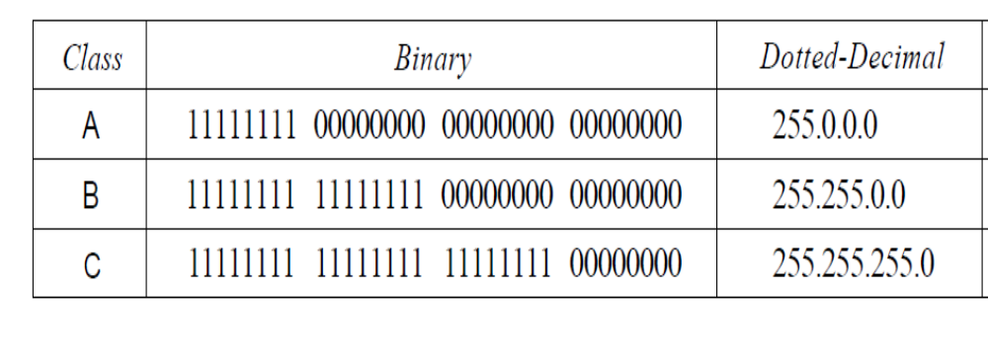

Slide 27
In classful addressing, a large part of the available addresses were wasted.
A block in class A address is too large for almost any organization. This means most of the addresses in class A were wasted and were not used.
A block in class B is also very large, probably too large for many of the organizations that received a class B block.
A block in class C is probably too small for many organizations.
Class D addresses were designed for multicasting. Each address in this class is used to define one group of hosts on the Internet. The Internet authorities wrongly predicted a need for 268,435,456 groups. This never happened and many addresses were wasted here too.
And lastly, the class E addresses were reserved for future use; only a few were used, resulting in another waste of addresses.

Slide 28
Address Depletion
The flaws in classful addressing scheme combined with the fast growth of the Internet led to the near depletion of the available addresses.
Since the addresses were not distributed properly the Internet was faced with the problem of addresses being rapidly used up resulting in address depletion.
To alleviate this problem subnetting and supernetting strategies were proposed.
Subnetting: Class A or Class B block is divided into several subnets.
Supernetting: Combine Class C blocks into larger block.
  Drawback – routing of the packets more difficult

Slide 29
Subnetting
During the era of classful addressing, subnetting was introduced.
If an organization was granted a large block in class A or B, it could divide the addresses into several contiguous groups and assign each group to smaller networks (called subnets) or, in rare cases, share part of the addresses with neighbors.
Subnetting increases the number of Is in the mask

Slide 30
Supernetting
The time came when most of the class A and class B addresses were depleted; however, there was still a huge demand for midsize blocks.
The size of a class C block with a maximum number of 256 addresses did not satisfy the needs of most organizations.
Even a midsize organization needed more addresses. One solution was supernetting.

Slide 31
In supernetting, an organization can combine several class C blocks to create a larger range of addresses. In other words, several networks are combined to create a supernetwork or a supernet.
An organization can apply for a set of class C blocks instead of just one.
For example, an organization that needs 1000 addresses can be granted four contiguous class C blocks. The organization can then use these addresses to create one supernetwork.
Supernetting decreases the number of Is in the mask. For example, if an organization is given four class C addresses, the mask changes from /24 to /22

Slide 32
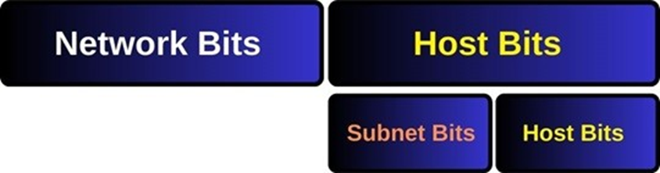
Subnetting
When a bigger network is divided into smaller networks, to maintain security, then that is known as Subnetting.
A subnet is used to divide a large network into a number of smaller, linked networks, which helps to minimize traffic. It reduces the need for traffic to use unnecessary routes, which speeds up the network.

Slide 33
Subnets and Subnet Masks
Allow arbitrary complexity of internetworked LANs within organization
Insulate overall internet from growth of network numbers and routing complexity
Site looks to rest of internet like single network
Each LAN assigned subnet number
Host portion of address partitioned into subnet number and host number
Local routers route within subnetted network

Slide 34
For Subnetting, Subnet Masks are used.
Subnet mask indicates which bits are subnet number and which are host number.
Subnets masks are 32 bit addresses like IP Addresses. Subnet Masks are used with IP Addresses. The 1s represents the network parts, and 0s represents the host parts.
Subnet Masks with four octets can be represented as IP addresses (255.255.255.0) or /X . Here, for the 255.255.255.0 Subnet Mask, we can use /24. This means that the first 24 bit is full of 1s and it is network part.

Slide 35
In Subnetting, there are two important terms. These are :
  CIDR (Classless Inter Domain Routing)
  VLSM (Variable Length Subnet Mask)
CIDR (Classless Inter Domain Routing) is the term that is used for using IP addresses independent from their traditional IP Classes. In other words, CIDR is using IP addresses without classes. The mask in the form /n where n can be 8, 16, or 24 in classful addressing. This notation is also called slash notation.
CIDR is used on the addresses that will advertise to the internet. So, it is used in the Internet Service Provider part.

Slide 36
VLSM (Variable Length Subnet Mask) is the term that is used for using different Subnet Mask for different sub networks. In other words, it is the mechanism that allows different Subnet Masks and provide division of a network into sub networks. It is like Subnet of subnets.
VLSM is used in a company or in smaller networks to use IP address spaces ideally.

Slide 37
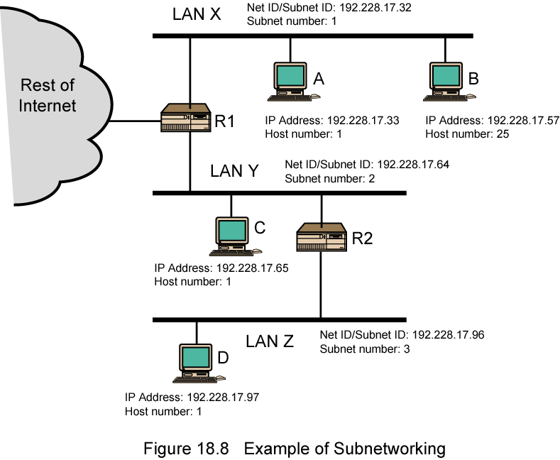
Routing Using Subnets

Slide 38

Subnet Mask
The 32-bit IP address contains information about the host and its network. It is very necessary to distinguish both.
For this, routers use Subnet Mask, which is as long as the size of the network address in the IP address.
Subnet Mask is also 32 bits long. If the IP address in binary is ANDed with its Subnet Mask, the result yields the Network address.
For example, say the IP Address is 192.168.1.152 and the Subnet Mask is 255.255.255.0 then −
This way the Subnet Mask helps extract the Network ID and the Host from an IP Address. It can be identified now that 192.168.1.0 is the Network number and 192.168.1.152 is the host on that network.

Slide 39
Classless Addressing
Address Depletion
The number of devices on the Internet is much less than the 2³² address space. We have run out of class A and B addresses, and a class C block is too small for most midsize organizations.
One solution that has alleviated the problem is the idea of classless addressing.

Slide 40
To overcome address depletion and give more organizations access to the Internet, classless addressing was designed and implemented.
In this scheme, there are no classes, but the addresses are still granted in blocks.
Extension of subnet idea to the whole Internet
Assigning IP numbers at any size together with a subnet number
A precaution against exhaustion of IP addresses

Slide 41
Special notation (CIDR notation)
CIDR or Classless Inter Domain Routing provides the flexibility of borrowing bits of Host part of the IP address and using them as Network in Network, called Subnet.
By using subnetting, one single Class A IP address can be used to have smaller sub-networks which provides better network management capabilities.
  network address/number of 1-bits in the mask
  e.g. 128.140.168.0/21
    subnet mask is 255.255.248.0
    Lowest host address 128.140.168.1
    Highest host address 128.140.175.254
Notes:
Lowest 128.140.168.1
Highest 128.140.175.254

Slide 42
Address Blocks
In classless addressing, when an entity, small or large, needs to be connected to the Internet, it is granted a block (range) of addresses.
The size of the block (the number of addresses) varies based on the nature and size of the entity.
For example, a household may be given only two addresses; a large organization may be given thousands of addresses.
An ISP, as the Internet service provider, may be given thousands or hundreds of thousands based on the number of customers it may serve.

Slide 43
Restriction
To simplify the handling of addresses, the Internet authorities impose three restrictions on classless address blocks:
1. The addresses in a block must be contiguous, one after another.
2. The number of addresses in a block must be a power of 2 (1, 2, 4, 8, ... ).
3. The first address must be evenly divisible by the number of addresses.

Slide 44
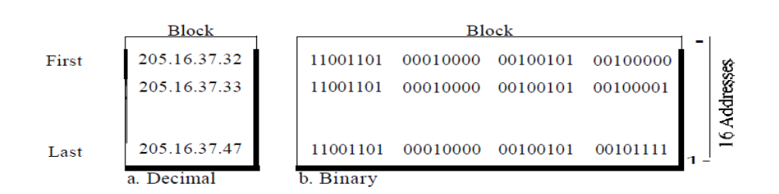
A block of16 addresses granted to a small organization
The addresses are contiguous.
The number of addresses is a power of 2 (16 = 2⁴ ), and the first address is divisible by 16.
The first address, when converted to a decimal number, is 3,440,387,360, which when divided by 16 results in 215,024,210.

Slide 45
Mask
A better way to define a block of addresses is to select any address in the block and the mask.
A mask is a 32-bit number in which the n leftmost bits are 1s and the 32 - n rightmost bits are 0s.
However, in classless addressing the mask for a block can take any value from 0 to 32.
It is very convenient to give just the value of n preceded by a slash (CIDR notation).

Slide 46
In 1Pv4 addressing, a block of addresses can be defined as x.y.z.t/n in which x.y.z.t defines one of the addresses and the /n defines the mask.
The address and the /n notation completely define the whole block (the first address, the last address, and the number of addresses).
First Address The first address in the block can be found by setting the 32 - n rightmost bits in the binary notation of the address to 0s.
Last Address The last address in the block can be found by setting the 32 - n rightmost bits in the binary notation of the address to 1s.
Number of Addresses: The number of addresses in the block is the difference between the last and first address. It can easily be found using the formula 2³² - n.

Slide 47
Example:
IP: 128.42.5.4
In binary: 10000000 00101010 00000101 00000100
Subnet: 255.255.248.0
determine the prefix, network, subnet, and host numbers?

Slide 48
Calculating the Netmask Length (also called a prefix):
Convert the dotted-decimal representation of the netmask to binary. Then, count the number of contiguous 1 bits, starting at the most significant bit in the first octet (i.e. the left-hand-side of the binary number).
255.255.248.0 in binary: 11111111 11111111 11111000 00000000
-----------------------------------
twenty-one 1s -------> /21
The prefix of 128.42.5.4 with a 255.255.248.0 netmask is /21.

Slide 49
Calculating the Network Address:
The network address is the logical AND of the respective bits in the binary representation of the IP address and network mask. Align the bits in both addresses, and perform a logical AND on each pair of the respective bits. Then convert the individual octets of the result back to decimal.

Slide 50
128.42.5.4 in binary: 10000000 00101010 00000101 00000100
255.255.248.0 in binary: 11111111 11111111 11111000 00000000
----------------------------------- [Logical AND] 10000000 00101010 00000000 00000000 ------> 128.42.0.0
The network address of 128.42.5.4/21 is 128.42.0.0

Slide 51
Calculating the Broadcast Address:
The broadcast address converts all host bits to 1s...
128.42.5.4 in binary: 10000000 00101010 00000101 00000100
The network mask is:
255.255.248.0 in binary: 11111111 11111111 11111000 00000000

Slide 52
This means our host bits are the last 11 bits of the IP address, because we find the host mask by inverting the network mask:
Host bit mask : 00000000 00000000 00000hhh hhhhhhhh
To calculate the broadcast address, we force all host bits to be 1s:
128.42.5.4 in binary: 10000000 00101010 00000101 00000100
Host bit mask : 00000000 00000000 00000hhh hhhhhhhh
----------------------------------- [Force host bits]
10000000 00101010 00000111 11111111 ----> 128.42.7.255

Slide 53
Calculating subnets:
128.42.0.0/21 into 4 subnets that must hold at least 100 hosts each
need at least a /25 prefix to contain 100 hosts
Why 25?
Calculate the prefix by backing into the number of host bits required to contain 100 hosts. One needs 7 host bits to contain 100 hosts.
subtract 7 from 32 to calculate the minimum subnet prefix for each subnet... 32 - 7 = 25.

Slide 54
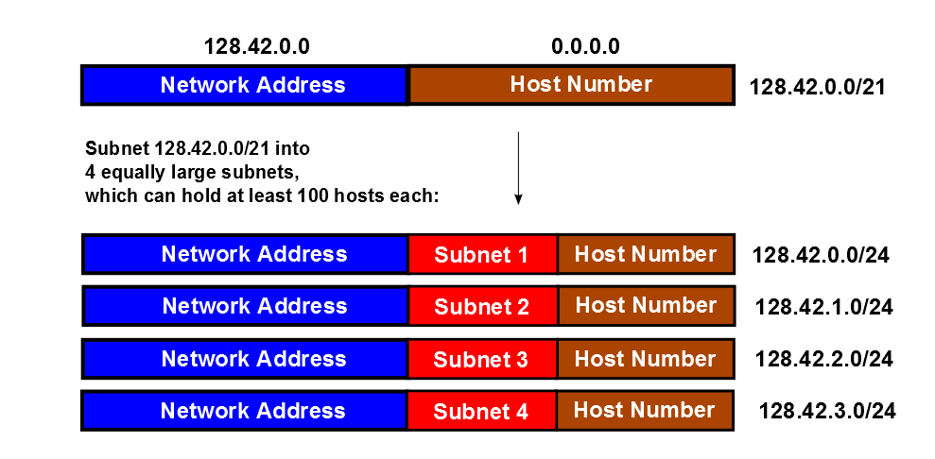

Slide 55
Calculating the maximum possible number of hosts in a subnet:
To find the maximum number of hosts, look at the number of binary bits in the host number above. The easiest way to do this is to subtract the netmask length from 32 (number of bits in an IPv4 address). This gives the number of host bits in the address.
Maximum Number of hosts = 2**(32 - netmask_length) - 2
The reason we subtract 2 above is because the all-ones and all-zeros host numbers are reserved. The all-zeros host number is the network number; the all-ones host number is the broadcast address.
Using the example subnet of 128.42.0.0/21 above, the number of hosts is...
Maximum Number of hosts = 2**(32 - 21) - 2 = 2048 - 2 = 2046

Slide 56
Finding the maximum netmask (minimum hostmask) which contains two IP addresses:
Suppose someone gives us two IP addresses and expects us to find the longest netmask which contains both of them; for example, what if we had:
128.42.5.17
128.42.5.67

Slide 57
The easiest thing to do is to convert both to binary and look for the longest string of network-bits from the left-hand side of the address.
128.42.5.17 in binary: 10000000 00101010 00000101 00010001
128.42.5.67 in binary: 10000000 00101010 00000101 01000011
^ ^ ^
| | |
+--------- Network ---------------------+Host-+
(All bits are the same) Bits
In this case the maximum netmask (minimum hostmask) would be /25

Slide 58
A block of addresses is granted to a small organization. We know that one of the addresses is 205.16.37.39/28.
First address in the block
The binary representation of the given address is 11001101 00010000 00100101 00100 I 11.
If we set 32 - 28 rightmost bits to 0, we get 11001101 000100000100101 0010000 or 205.16.37.32.

Slide 59
Last address for the block
The binary representation of the given address is 11001101 000100000010010100100111. If we set 32 - 28 rightmost bits to 1, we get 11001101 00010000 001001010010 1111 or 205.16.37.47.
Number of addresses
The value of n is 28, which means that number of addresses is 2³²- 2⁸
or 16

Slide 60
a. The first address can be found by ANDing the given addresses with the mask.
Address: 11001101 00010000 00100101 00100111
Mask: 11111111 11111111 11111111 11110000
First address: 11001101 00010000 00100101 00100000

Slide 61
b. The last address can be found by ORing the given addresses with the complement of the mask.
Address: 11001101 00010000 00100101 00100111
Mask complement: 00000000 00000000 00000000 00001111
Last address: 11001101 00010000 00100101 00101111

Slide 62
c. The number of addresses can be found by complementing the mask, interpreting it as a decimal number, and adding 1 to it.
Mask complement: 000000000 00000000 00000000 00001111
Number of addresses: 15 + 1 =16

